Slide 1
A High-Performance Triple Patterning Layout Decomposer with Balanced Density
Presenter: Chien-Yi Yang
IEEE ICCAD’13
Bei Yu, Yen-Hung Liny, Gerard Luk-Patz, Duo Dingx, Kevin Lucasz, David Z. Pan
The Electronic Design Automation Laboratory
Graduate Institute of Electrical Engineering
National Taiwan University
Taipei 106, Taiwan

Slide 2
Outline
Introduction
Algorithms
Experimental Results
Conclusion

Slide 3
Outline
Introduction
Algorithms
Experimental Results
Conclusion

Slide 4


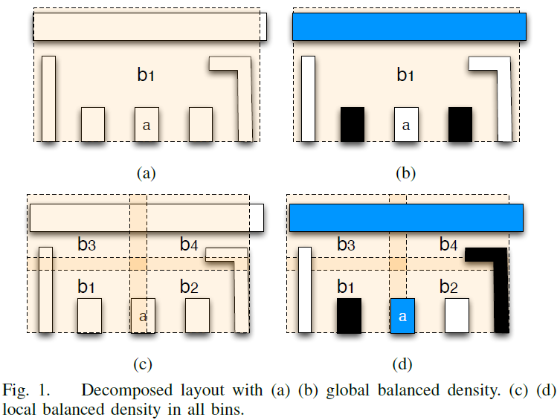
Problem Formulation
Definition
Local Density Uniformity( ):
Problem Formulation
Assign all vertices in the decomposition graph into three colors (masks) to minimize the stitch number and the conflict number, while keeping all density uniformities as small as possible

Slide 5
Outline
Introduction
Algorithms
Proposed Flow
Dynamic IR drop prediction
Dynamic IR drop aware cell movement
Experimental Results
Conclusion

Slide 6
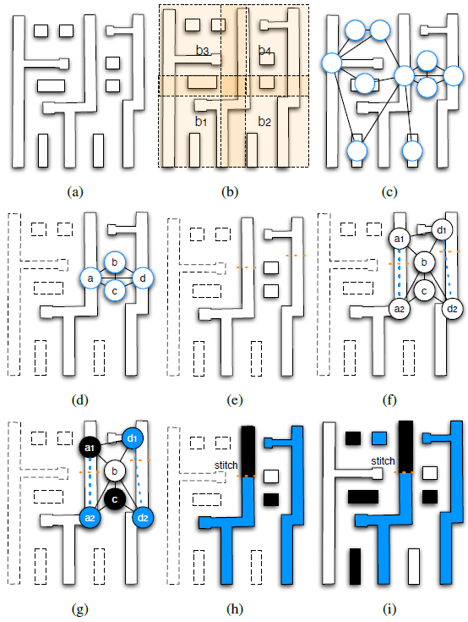
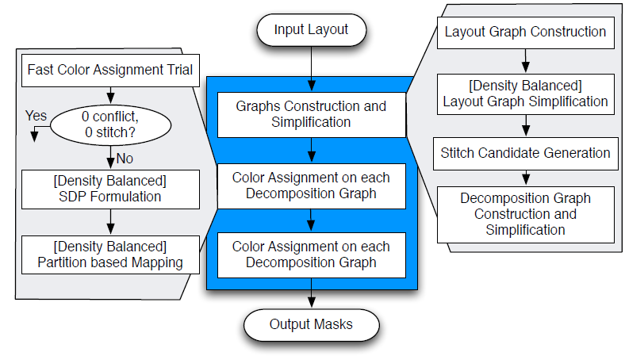
Algorithm Flow

Slide 7
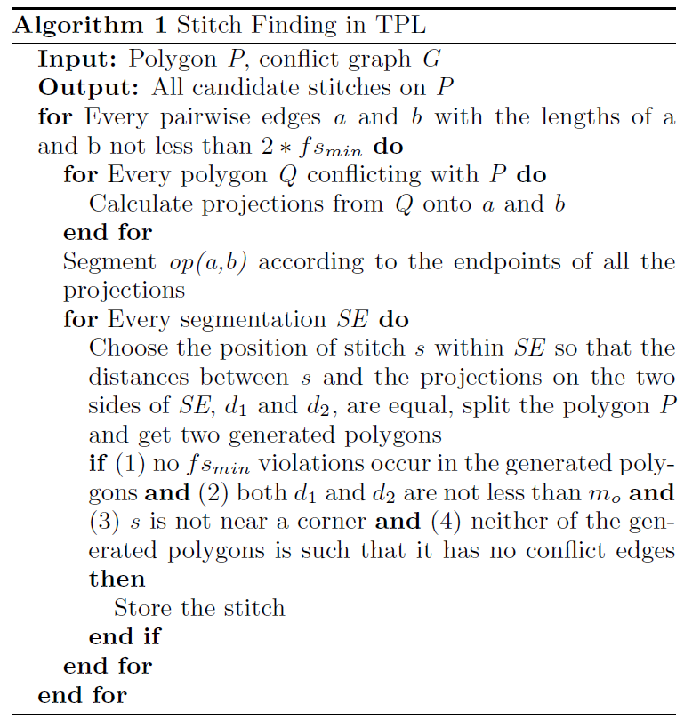
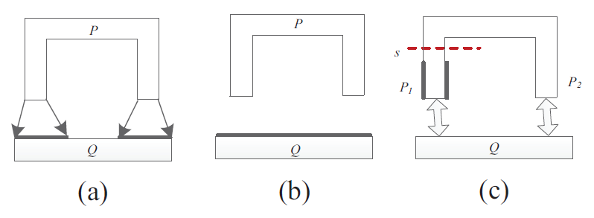
Stitch Finding

Slide 8
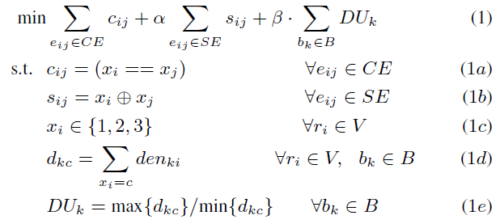
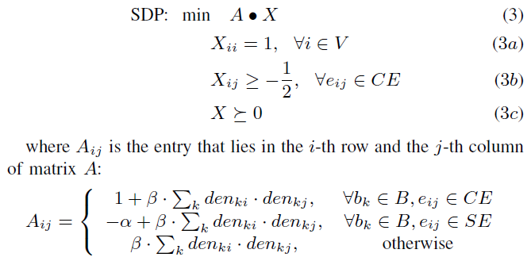
Density Balanced SDP(Semidefinite Programming)
Mathematical Formulation
SDP Formulation

Slide 9
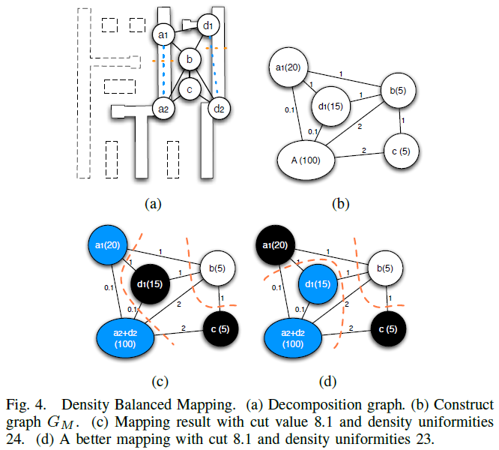
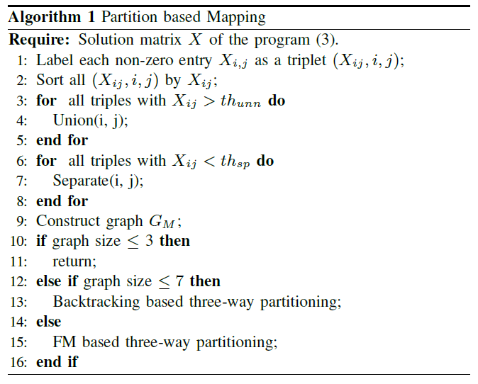
Density Balanced Mapping

Slide 10
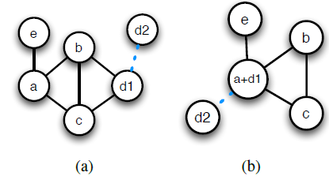
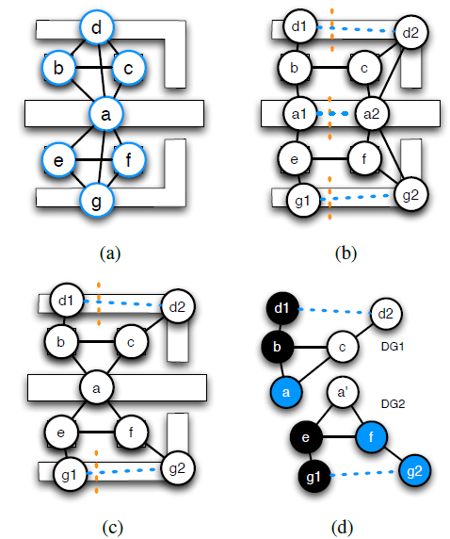
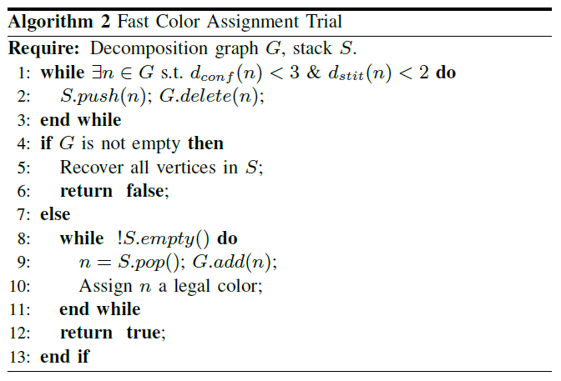
Speedup Techniques
LG Cut Stitch Forbiddance
Decomposition Graph Vertex Clustering
Fast Color Assignment Trial

Slide 11
Outline
Introduction
Problem Formulation
Experimental Results
Conclusion

Slide 12
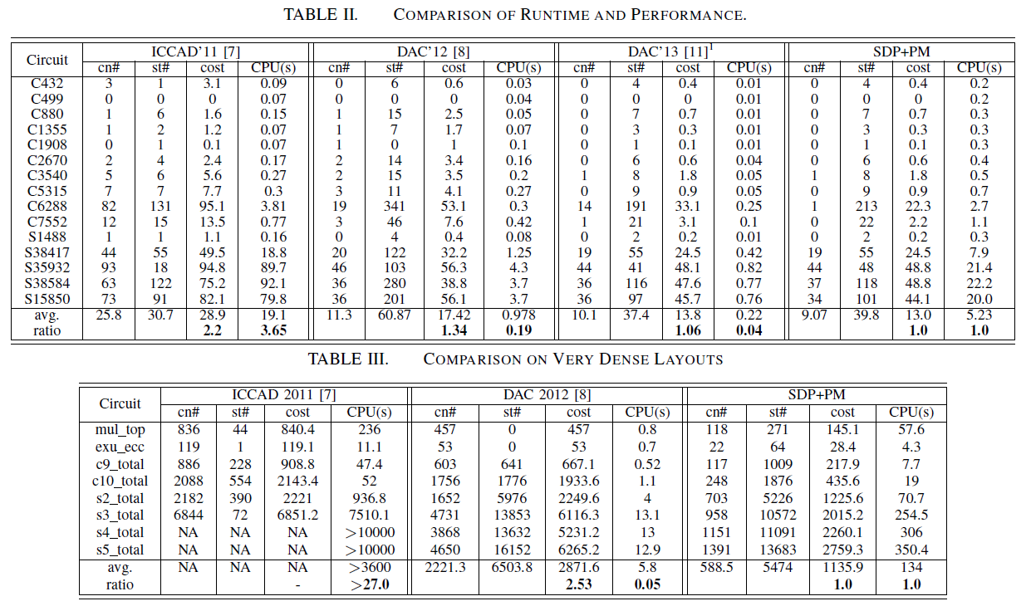
Experimental Results

Slide 13
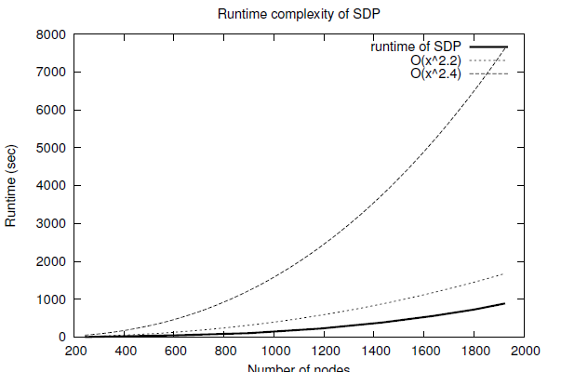
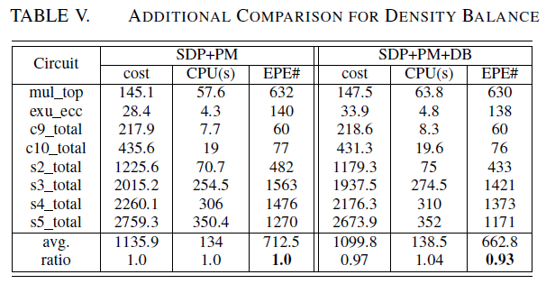
Experimental Results

Slide 14
Outline
Introduction
Algorithms
Experimental Results
Conclusion

Slide 15
Conclusion
Density balancing is integrated into all the key steps of the decomposition flow
Propose a set of speedup techniques, such as layout graph cut vertex stitch forbiddance, decomposition graph vertex clustering, and fast color assignment trial

Slide 16

Thank You!

